Slide 1
Don’t Care Conditions

Slide 2
Introduction
There are applications where certain combinations of input variables never occur.
A four-bit decimal code, has six combinations which are not used.
The function output is don’t care for these combinations of the variables because they are guaranteed never to occur.
‘X’ is used to represent don’t care condition
‘X’ can be mapped either with 0’s or 1’s to obtain the simplified form of the function

Slide 3
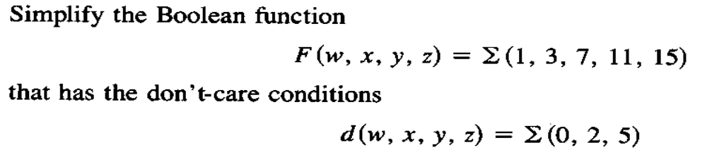
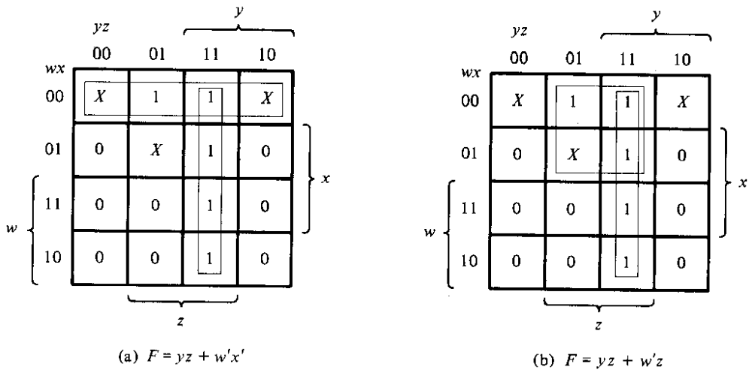
Example

Slide 4
To obtain PoS form
Y′Z′ Y′Z YZ YZ′
W′X′
W′X
WX
WX′
X | 1 | 1 | X
0 | X | 1 | 0
0 | 0 | 1 | 0
0 | 0 | 1 | 0
F′ = Z′ + WY′ F = Z(W′ + Y)

Slide 5
Don’t Care Condition
Reduce the following function using k-map technique and implement using basic gates.
F(A,B,C,D)= MAX TERMS ( 0, 3, 4, 7, 8, 10, 12, 14 ) + (d) DON’T CARE (2,6 )

